Slide 1
Crime Prediction using Deep Learning
Nasir Khalid | 65082
Yousif Khaireddin | 63618
May 21st 2019

Slide 2
Outline
Introduction
Datasets Used
Data Processing
Final Dataset
Networks Trained
References

Slide 3
Introduction
Predicting crime is extremely costly and time consuming
Crime is dependent on various different factors such as weather, location, social and economic factors [1]
Objective
Developing a neural network that is capable of predicting within the city of Vancouver

Slide 4
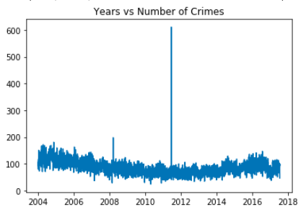
Datasets Used
Vancouver Crime
530652 crimes from 2003 to 2017 detailing:
Type
Time
Location
Neighborhood
The latitude/longitude mapping of the center of each of the 22 neighborhood in Vancouver
Number of Crimes in Vancouver from 2003 – 2017

Slide 5
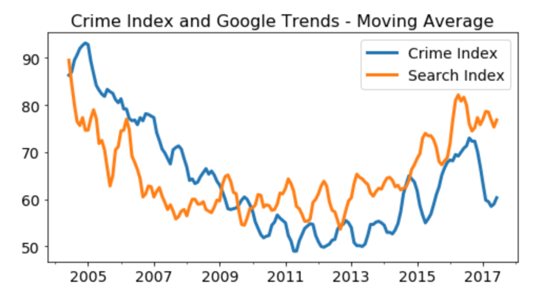
Datasets Used
Graffiti
8508 locations at Vancouver that contain graffiti
Water Fountains
241 locations at Vancouver that contain water fountains
Google “Crime” Trends
A normalized monthly value that describes the amount at which the word “crime” has been searched
Crime Correlation with Google Trends [2]

Slide 6
Data Processing
Distance from graffiti
Done through creating specific a program that takes each crime sample and cross checking all graffiti locations to obtain the closest one and its distance from the crime location
Distance from water fountains
Done through reusing the program created for graffiti locations
Google “Crime” Trends
Creating a specific program that takes each crime sample and returns the crime index value of the previous month
Up-Sampling
To account for all days without crime
Must be done in every neighbourhood
Notes:
Yousef

Slide 7
Final Dataset
Type of Crime
Year
Month
Day
Hour
Minute
Latitude
Longitude
Neighbourhood
Block of Crime
Distance from nearest Graffiti
Distance from nearest Drinking Fountain
Google Trend Data for previous month
Notes:
Yousef

Slide 8
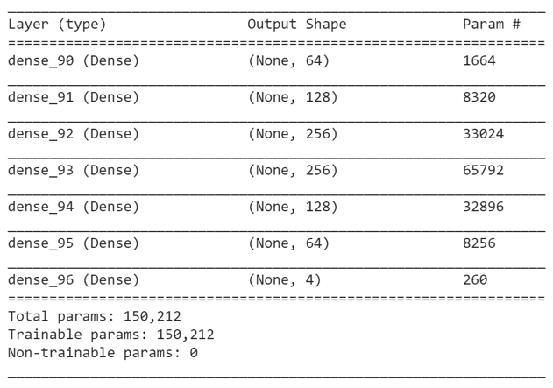
Network Architectures
Difficulty in implementing RNNs or CNNs
All networks were regular feedforward networks
Water fountains and Graffiti locations provide some sense of special features
Previous Google trends provide some sense of temporal features
Notes:
Yousef

Slide 9
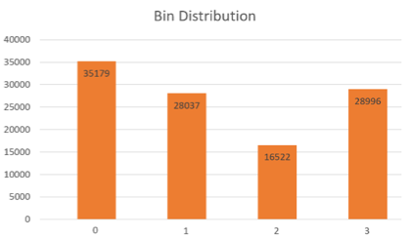
Network 1 Description
Input
Year
Month
Day
Neighborhood
Output
Number of crimes likely to occur
Class 0: 0 – 1 crimes
Class 1: 2 - 3 crimes
Class 2: 4 - 5 crimes
Class 3: Greater than 5 crimes
Distribution of crime within the class ranges chosen
Notes:
Yousef

Slide 10
Network 1 Architecture
Notes:
Yousef

Slide 11
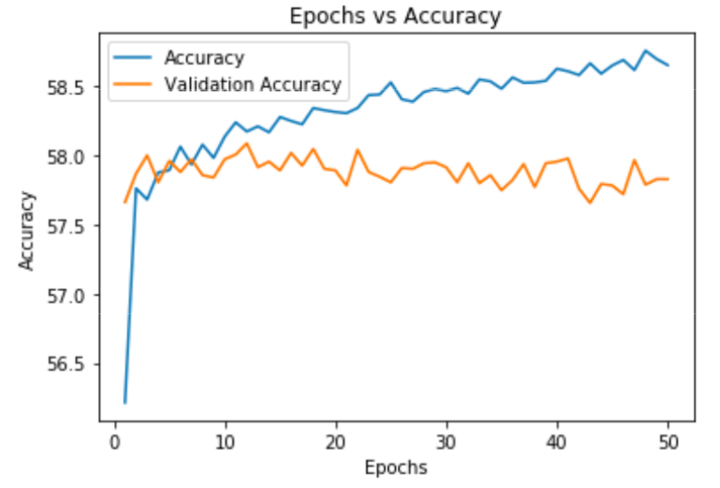
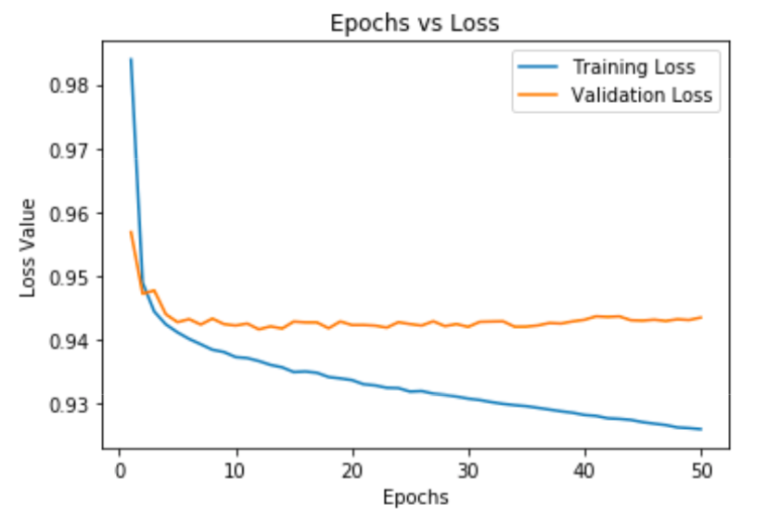
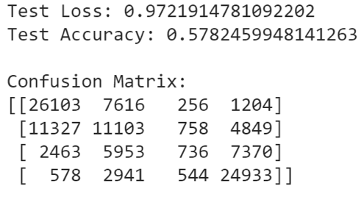
Network 1 Performance
Notes:
Yousef

Slide 12
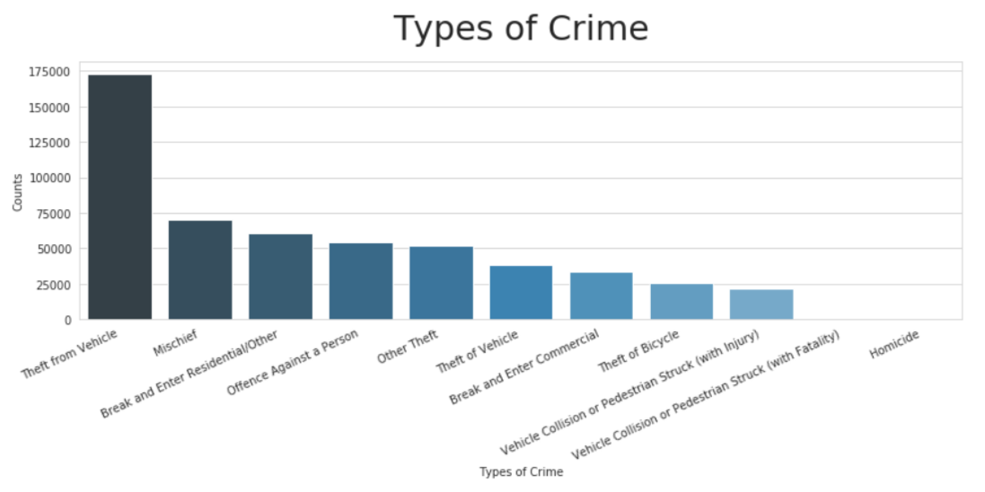
Network 2 Description
Input
Year
Month
Day
Latitude
Longitude
Distance to closest graffiti
Distance to closest drinking fountain
Output
A vector with a probability associated to each type of crime
Distribution of Crime Types
Notes:
Yousef

Slide 13
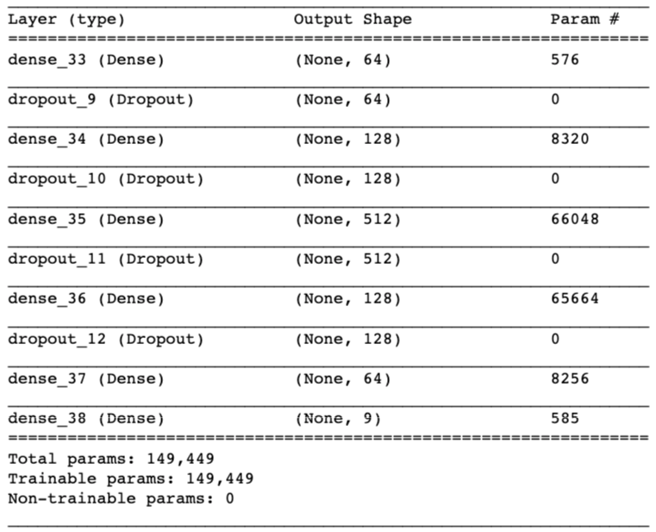
Network 2 Architecture
Notes:
Yousef

Slide 14
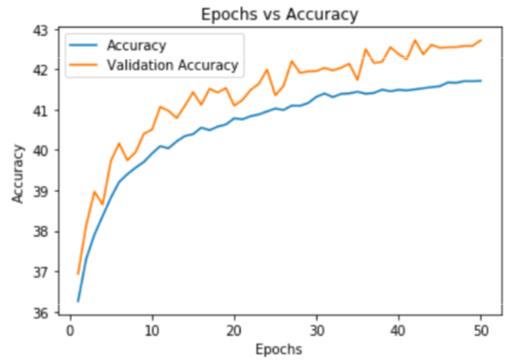
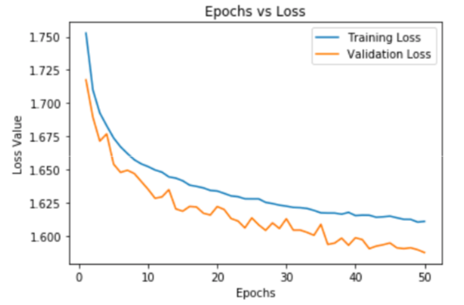
Network 2 Performance
Test Accuracy: 43%
Notes:
Yousef

Slide 15
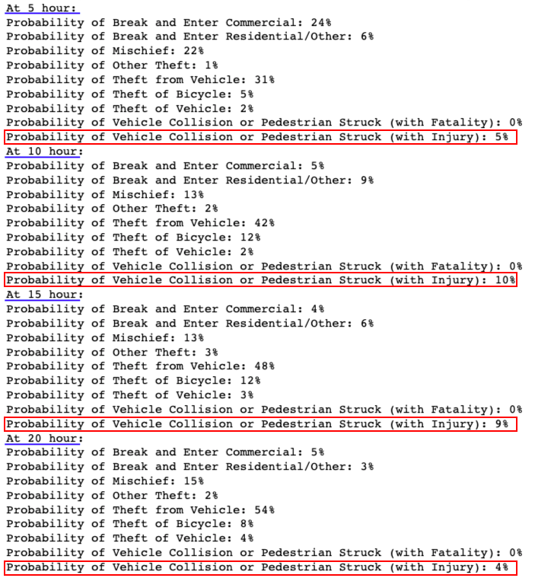
Network 2 Sample Output
Notes:
Yousef

Slide 16
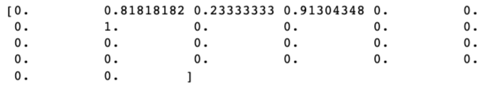
Network 3 Description
Input
Year
Month
Day
Hour
One hot encoded Neighborhood
Output
Probability of crime occurring
New 26 column input vector
Notes:
Yousef

Slide 17
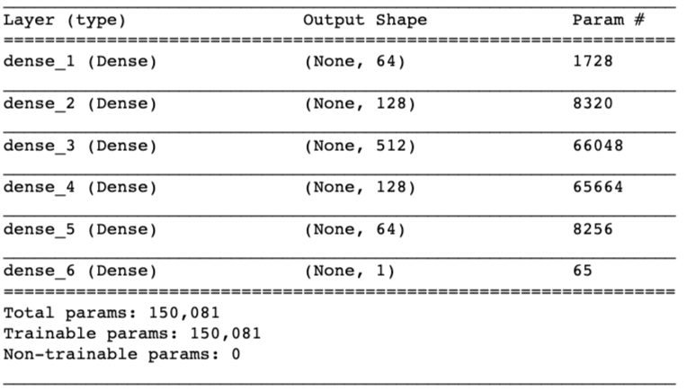
Network 3 Architecture
Notes:
Yousef

Slide 18
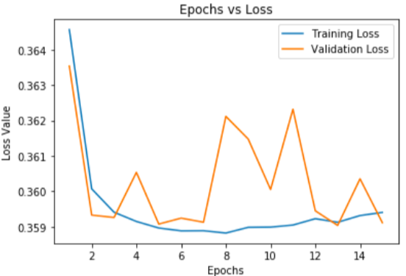
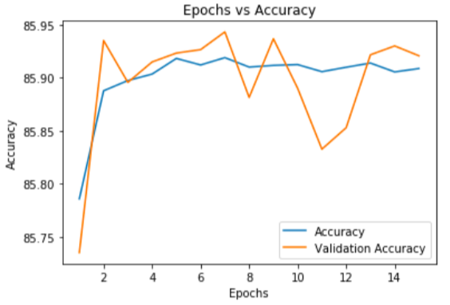
Network 3 Performance
Test Accuracy: 86%
Notes:
Yousef

Slide 19
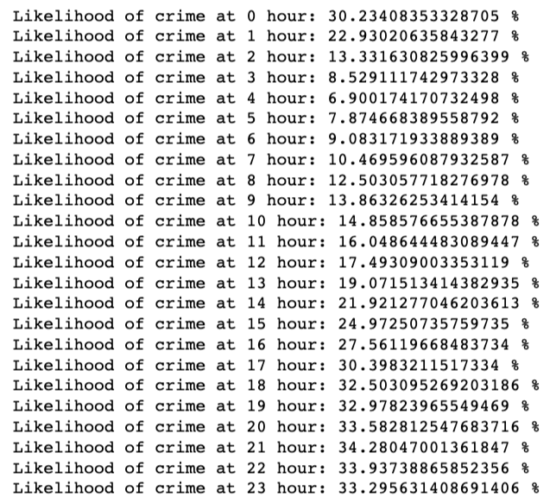
Network 3 Sample Output
Notes:
Yousef

Slide 20
Network 3.1 and 3.2
Input
Year
Month
Day
Hour
Minute
Latitude
Longitude
Distance from Graffiti
Distance from Drinking Fountain
Output
Probability of crime occurring
Input
Year
Month
Day
Hour
Minute
Latitude
Longitude
Distance from Graffiti
Distance from Drinking Fountain
Google Trend Data
Output
Probability of crime occurring
Network 3.1
Network 3.2
Notes:
Yousef

Slide 21
Network 3.1 and 3.2 Architecture
Notes:
Yousef

Slide 22
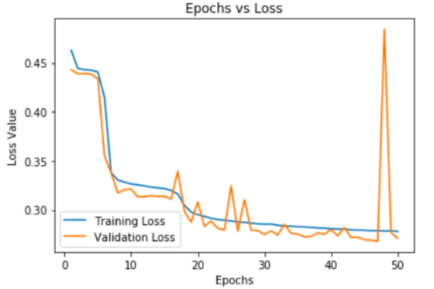
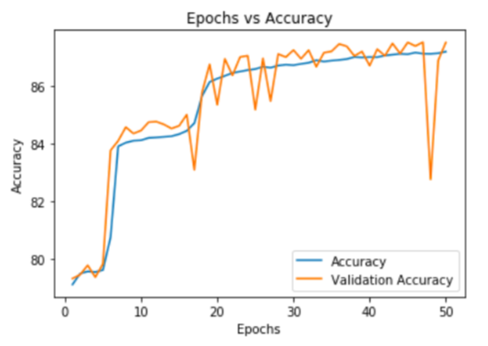
Network 3.1 Performance
Test Accuracy: 87.23 %
Notes:
Yousef

Slide 23
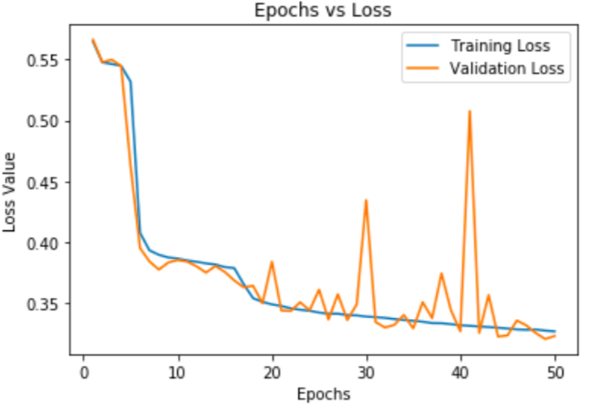
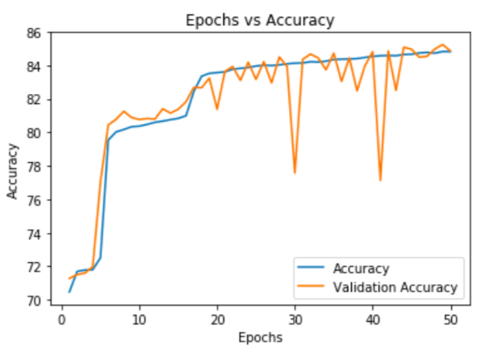
Network 3.2 Performance
Test Accuracy: 84.69 %
Notes:
Yousef

Slide 24
Network 4 Description
Input
Year
Month
Day
Hour
Output
Neighborhoods that will have crime
Sample labels vector
Notes:
Yousef

Slide 25
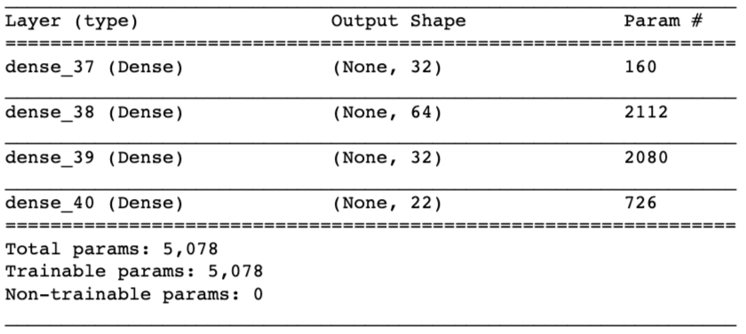
Network 4 Architecture
Notes:
Yousef

Slide 26
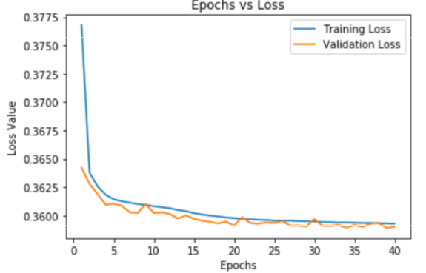
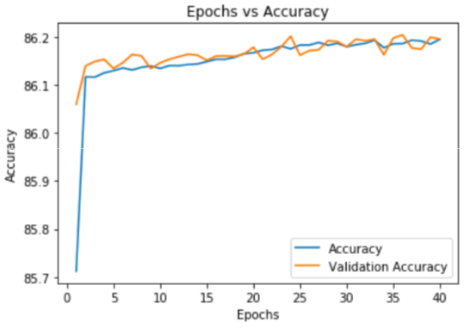
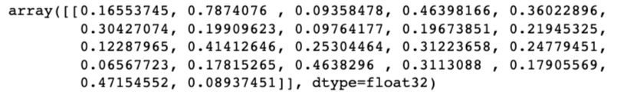
Network 4 Performance
Test Accuracy: 86.15 %
Notes:
Yousef

Slide 27
Network 4 Sample Output
Notes:
Yousef

Slide 28
Conclusion
Using one network alone is not enough
Using multiple different networks in conjunction to predict different attributes is key.
Network 2 and 4 together can be used to predict where crime will happen and what type of crime it will be
Notes:
Yousef

Slide 29
References
[1] P. Carlen, Women, Crime and Poverty. Open University Press, dec 1988.
[2] "Google Trends vs Crimes in Vancouver | Kaggle", Kaggle.com, 2019. [Online]. Available: https://www.kaggle.com/wosaku/google-trends-vs-crimes-in-vancouver.
[3] N. Khalid and Y. Khaireddin, "ELE494-Project", GitHub, 2019. [Online]. Available: https://github.com/NasirKhalid24/ELE494-Project.
Notes:
Yousef

